Slide 1
.NET and Visual Studio IDE
Ramaswamy Krishnan Chittur

Slide 2
.NET
What is .NET:
.NET is a free, cross-platform, open-source developer platform for building many kinds of applications.
Types of apps supported:
Cloud apps, Cross-platform client apps, Windows Desktop apps, Other app types like ML/IoT.
Compilation:
.NET apps (as written in a high-level language like C#) are compiled into an Intermediate Language (IL). IL is a compact code format that can be supported on any operating system or architecture. Most .NET apps use APIs that are supported in multiple environments, requiring only the .NET runtime to run.
Runtime:
The Common Language Runtime (CLR) is the foundation all .NET apps are built on. The fundamental features of the runtime are: Garbage collection, Memory safety and type safety, High level support for programming languages, Cross-platform design.
Managed code.
Languages supported:
C#, F#, VB .NET, C++/CLI, …
Reference:
.NET (and .NET Core) - introduction and overview | Microsoft Learn
What is managed code? | Microsoft Learn

Slide 3
Flavors of .NET
 | OS | Open Source | Purpose
.NET Framework | Windows | No | Used for building Windows desktop applications and ASP.NET Web apps running on IIS.
.NET Core | Windows, Linux, macOS | Yes | Used for building cross-platform console apps and ASP.NET Core Web apps and cloud services.
Xamarin | iOS, Android, macOS | Yes | Used for building mobile applications for iOS and Android, as well as desktop apps for macOS.
.NET Standard | N/A | Yes | Used for building libraries that can be referenced from all .NET implementations, such as .NET Framework, .NET Core and Xamarin

Slide 4
Managed code
Code whose execution is managed by a runtime. In this case, the runtime in question is called the Common Language Runtime or CLR, regardless of the implementation (for example, Mono, .NET Framework, or .NET Core/.NET 5+).
Contrast this to the way you would run a C/C++ program, also called "unmanaged code". In the unmanaged world, the programmer is in charge of pretty much everything. The actual program is, essentially, a binary that the operating system (OS) loads into memory and starts. Everything else, from memory management to security considerations are a burden of the programmer.
Intermediate Language (IL) & Execution: What is managed code? | Microsoft Learn
Automatic Memory Management | Microsoft Learn

Slide 5
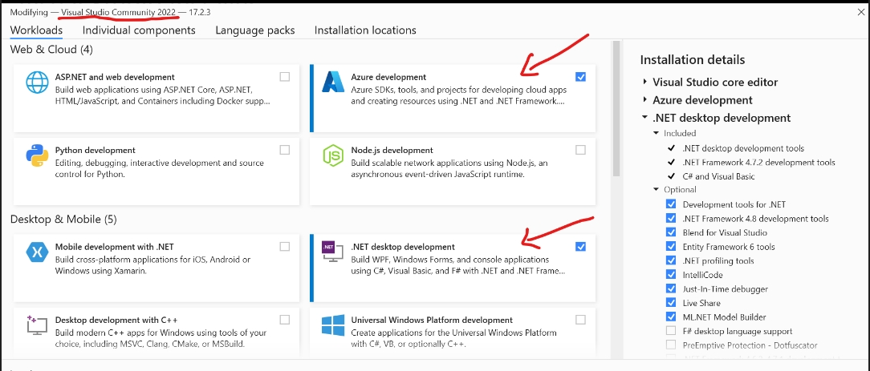
Installing Visual Studio
Installing VS:
https://www.youtube.com/watch?v=3AghgkZEU2w&authuser=1
Modify Visual Studio workloads, components, & language packs | Microsoft Learn
Workloads Required:

Slide 6
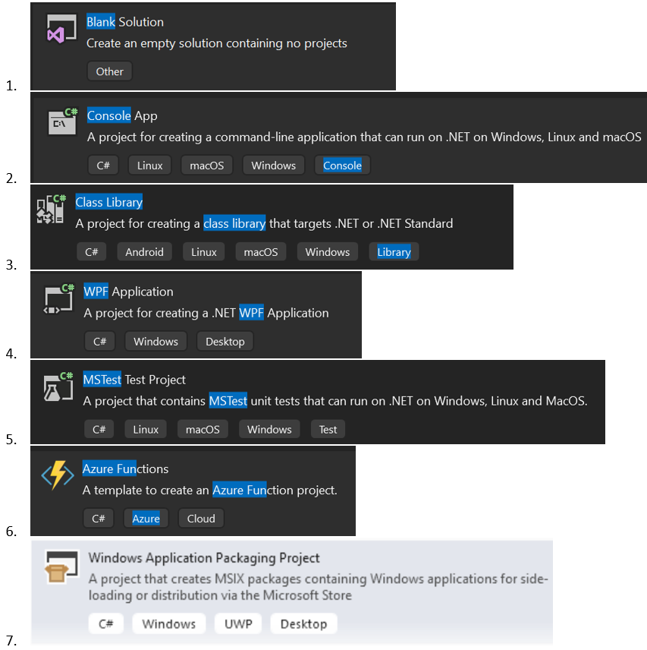
Visual Studio Project Types

Slide 7
Code development using Visual Studio
Writing your first app: Create a .NET console application using Visual Studio - .NET | Microsoft Learn
Debug the app: Debug a .NET console application using Visual Studio - .NET | Microsoft Learn
Publish the app: Publish a .NET console application using Visual Studio - .NET | Microsoft Learn
Create a class library: Create a .NET class library using Visual Studio - .NET | Microsoft Learn
Unit test the library: Test a .NET class library using Visual Studio - .NET | Microsoft Learn
Install and use a package: Quickstart: Install and use a NuGet package in Visual Studio (Windows only) | Microsoft Learn
Create and publish a package: Quickstart: Create and publish a NuGet package using Visual Studio (Windows only) | Microsoft Learn
Legend: This -> Mandatory. This -> Optional.

